Slide 1
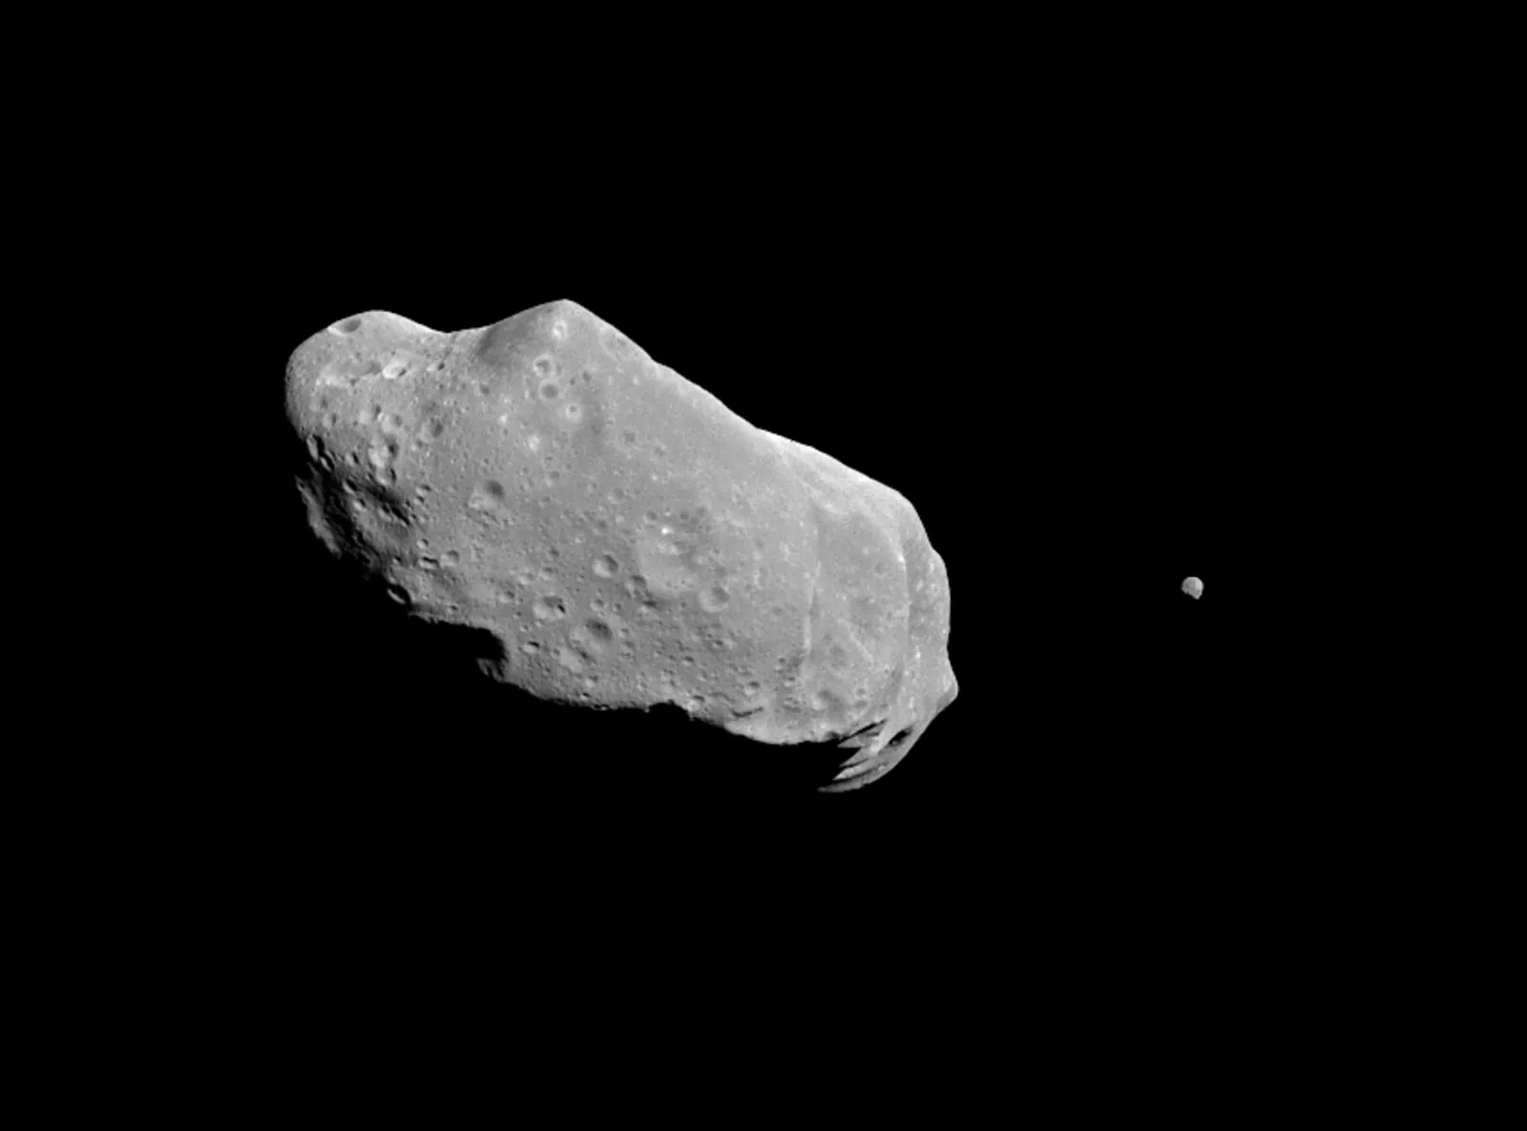
Asteroid Tracking & Rendezvous with Convex Optimization and State Estimation Techniques
Chris Mitchell, Graham Shunk, Ashok Viswanathan

Slide 2
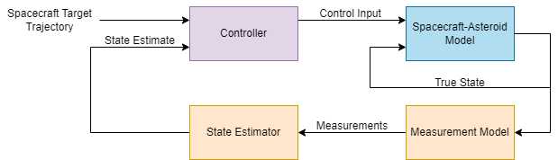
Project Goals:
Accurately estimate the state of a two body, one agent system over time
Use estimated states to find the optimal control with a convex optimizer
Compare the performance of the EKF, UKF, and Particle filter.
Notes:
Graham
An asteroid is projected to collide with Earth in 2 days, and one of our satellites halfway between apogee and perigee, is commanded to fly out towards the asteroid to try and knock it off it’s path.
To have a successful mission, we’d like to
…
…

Slide 3
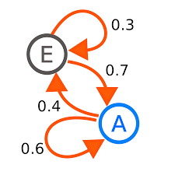
Assumptions
Spacecraft feels no gravitation attraction from the earth
Assume constant m_{rocket}
2D Nonlinear Dynamics Model
Conditionally Independent Measurements
Markovian System
Gaussian White Noise
Notes:
Graham

Slide 4
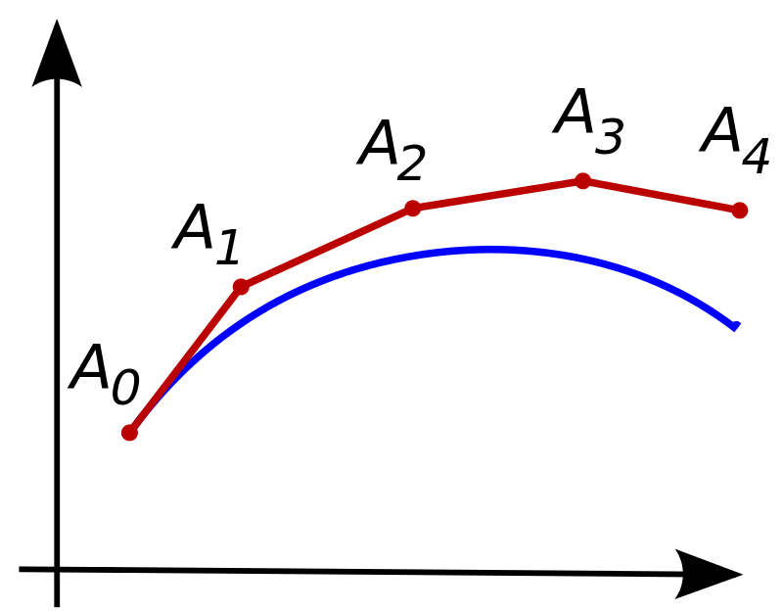
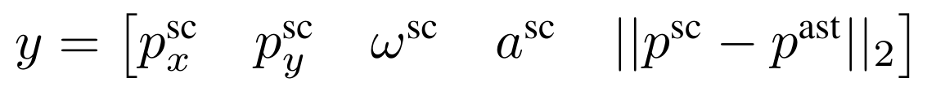
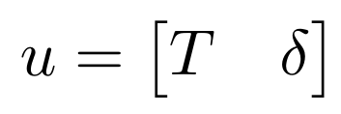

2D Problem Formulation
State:
Measurement:
Control Input:
Dynamics Step:
N steps: 950
Generate a noisy, ground truth history of measurements & controls, online.
Notes:
Graham
[just read out each variable]
Could have made control input more convenient, but we wanted to be realistic
Now, we are going to look at our dynamics in more depth

Slide 5
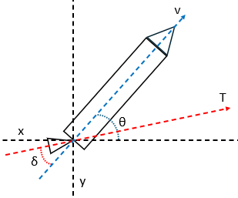
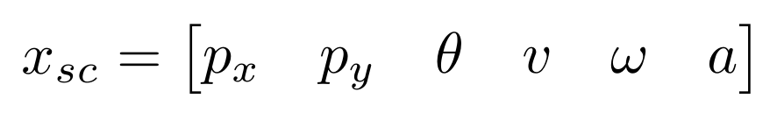
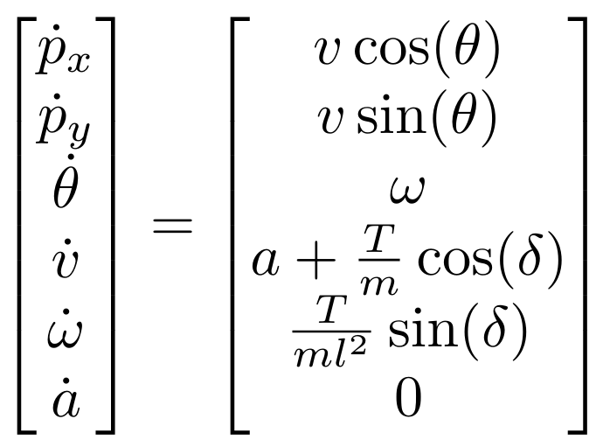
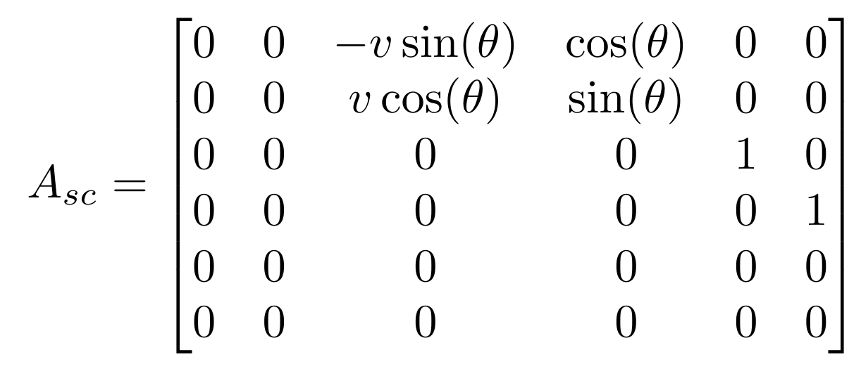
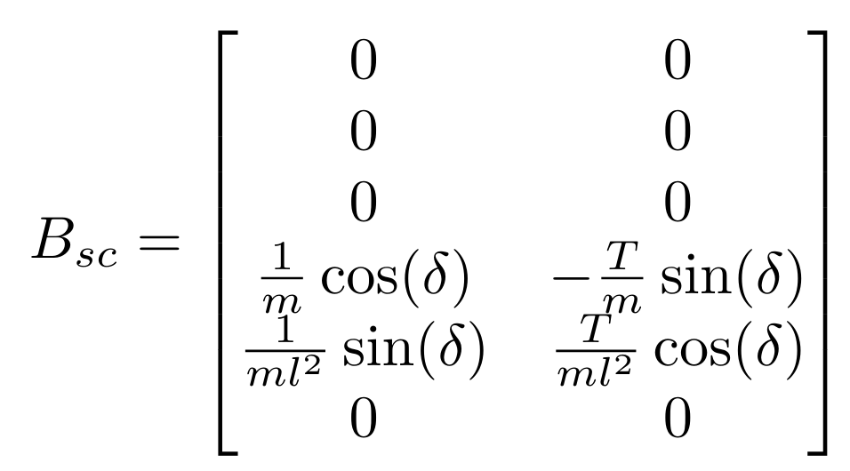
Spacecraft Dynamics Model
State:
Input:
Dynamics: Jacobian:
Notes:
Chris

Slide 6
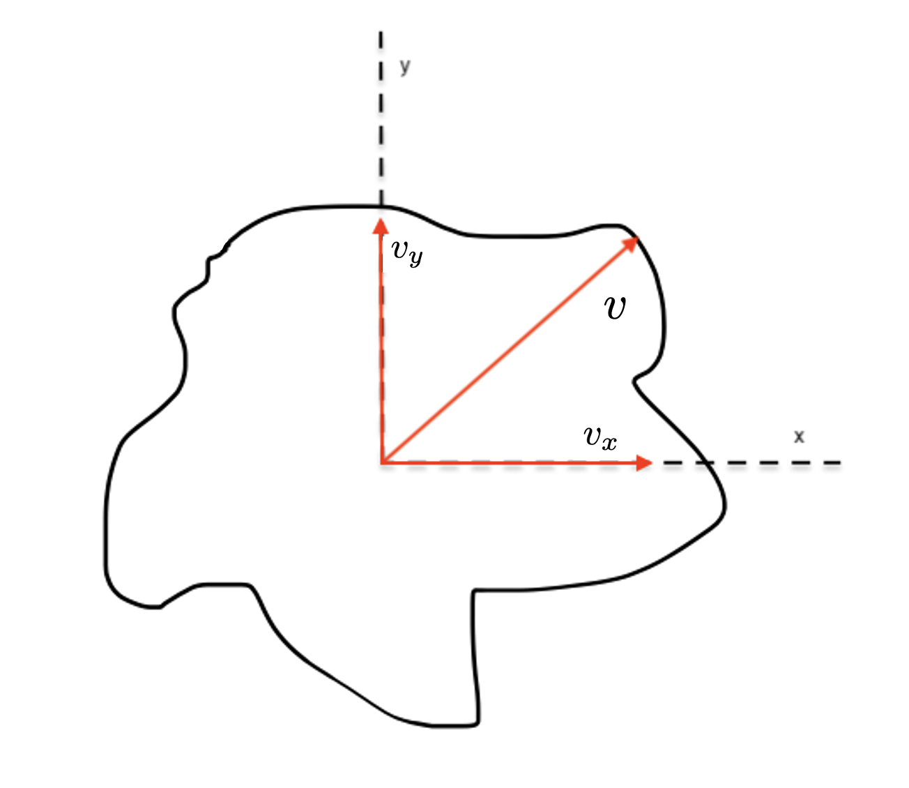
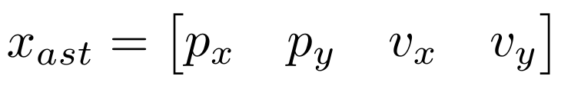
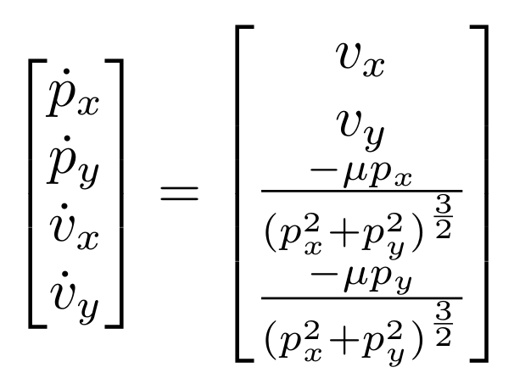
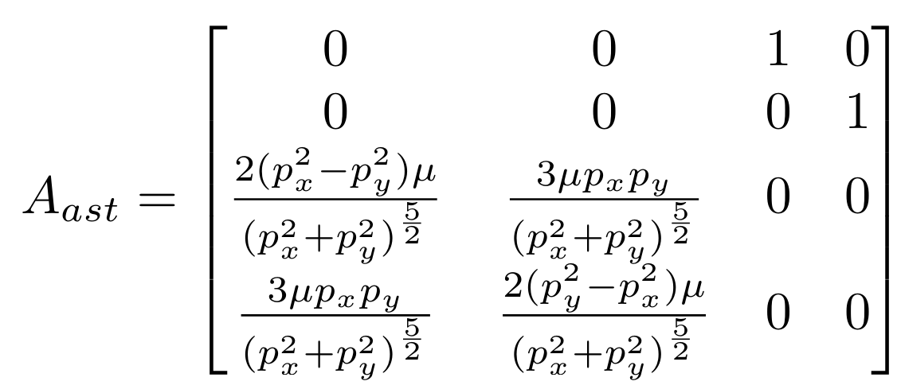
Asteroid Dynamics Model
State:
Dynamics: Jacobian:
Notes:
Chris

Slide 7
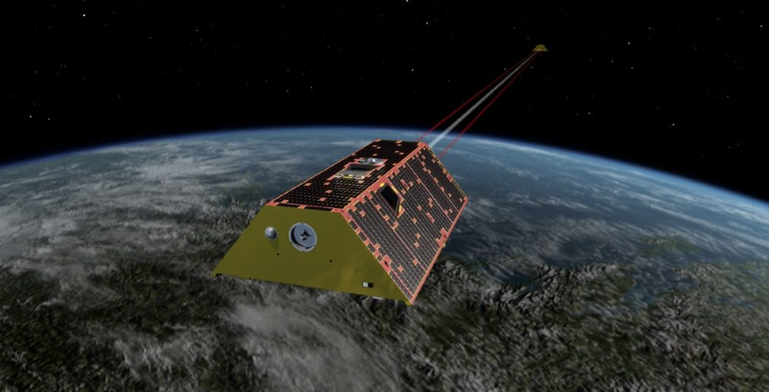
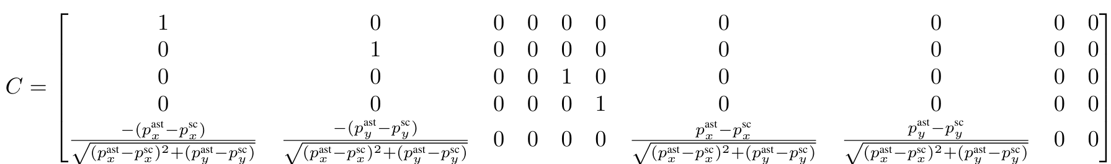
Measurement Model
Sensors:
→ Ranging, IMU, and Laser Rangefinder
Measurement:
Jacobian:
Notes:
Chris

Slide 8
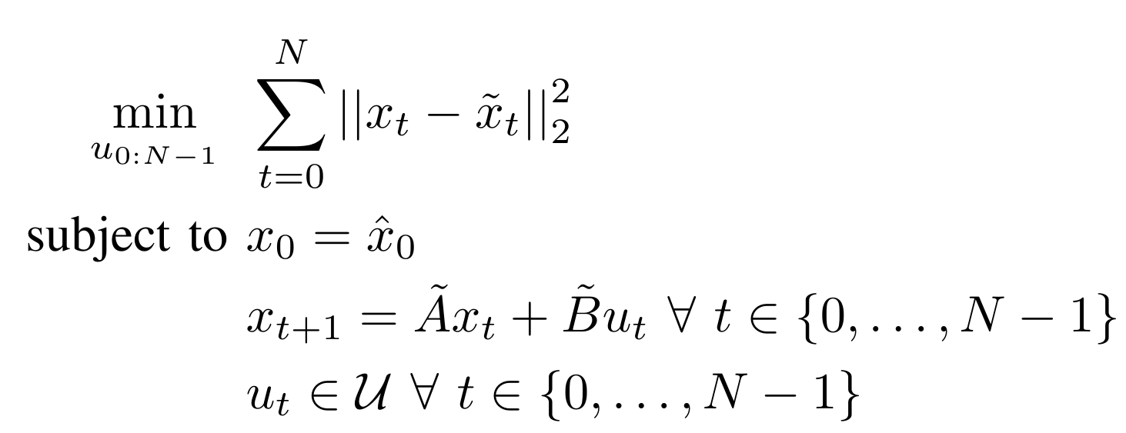
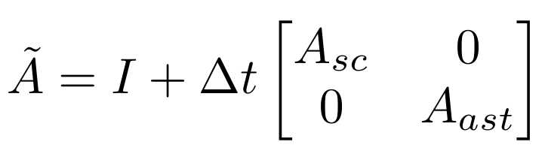
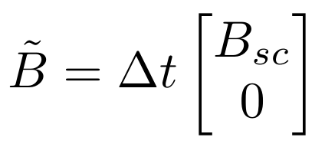
MPC
The controller aims to minimize the L2 distance to a given trajectory over a finite time horizon N.
The optimization is subject to constraints:
→ Set the first state to the initial conditions
→ All states must be linked together through the system state space dynamics
→ Control inputs must be within the allowable range
At each time step, MPC solves the optimization problem, the first control action is implemented, the next state is estimated, and repeat.
Notes:
Chris

Slide 9
Encountered Problems & Solutions
Problem: MPC Numerical Instability
Solution: switched from SI units to canonical units (distance in terms of Earth radii)
Problem: Spacecraft was going very fast upon rendezvous
Solution: We now claim that we’re knocking asteroid off it’s path (instead of rendezvous)
Problem: Estimating the asteroid and spacecraft state separately was very inconvenient
Solution: We stacked the asteroid and spacecraft state into a single vector
Problem: MPC could not follow trajectory AND path plan simultaneously
Solution: (next slide)
Notes:
Chris
4th problem
The controller needs a desired trajectory to minimize against, and this raised some issues.

Slide 10


MPC: Path Planning and Trajectory Following
MPC does a great job trajectory following, but not path planning.
Initially, we asked it to do both…
Solution:
→ maintain trajectory prior at each t:
→ Approximate trajectory is a straight line from
T=t
T=N
T=t
Notes:
Ashok- initially we wanted to do path planning with the MPC however, this did not yield satisfactory results. We then gave the MPC a nominal ,dynamically feasible trajectory to follow and as a feedback controller worked quite well. We initially tried to use scipy’s non-linear optimizer to get an optimal nominal trajectory however it did not converge. Thus we stuck to a simple nominal trajectory.
Velocity is not observable, so we use X_t, X_{t-1} to extrapolate
asteroid at t_N and make our trajectory a straight line approximation.

Slide 11
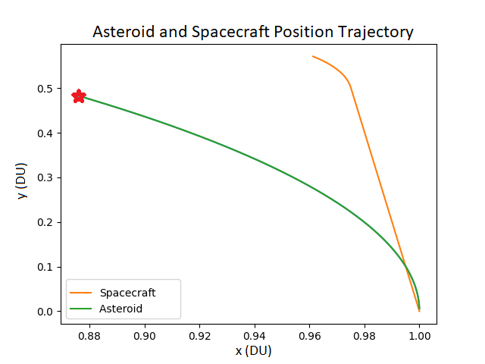
Problematic Plots: MPC Path Planning
Notes:
Ashok-

Slide 12
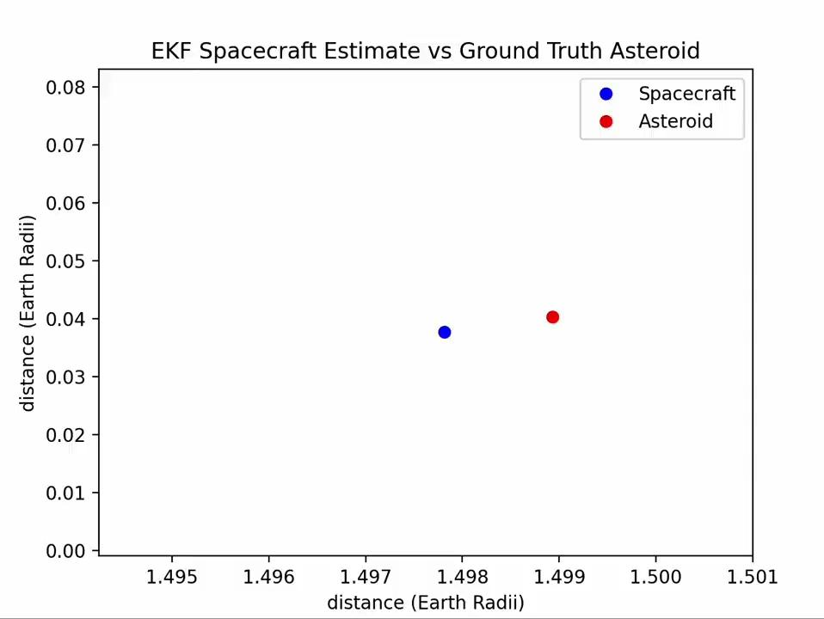
Results: EKF Animation
Notes:
Graham
We wanted to keep our satellite and asteroid roughly no more than 40km apart, according to the specs of a military range finder, as this is the maximum distance at which we can make high quality measurements. This is why the spacecraft and asteroid seemingly close together… that initial distance is actually 40km, while one unit of distance is 6,738km (the radius of earth).
We see that, the spacecraft does a very good job of finding the asteroid.

Slide 13
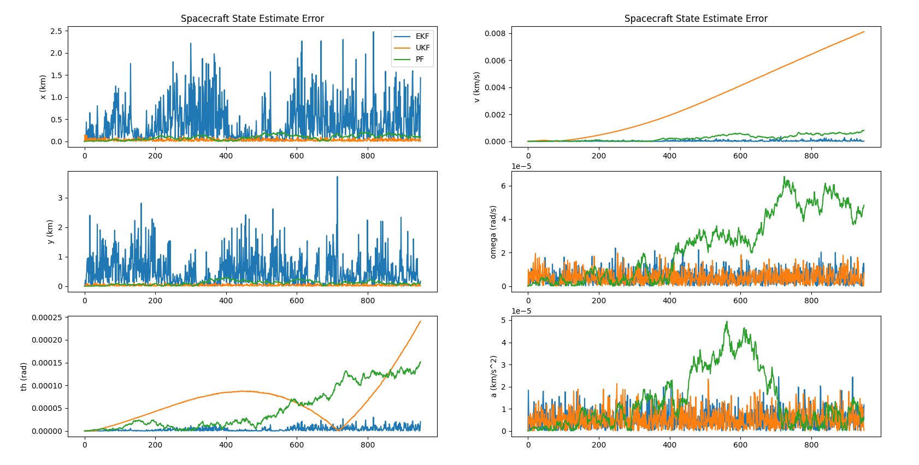
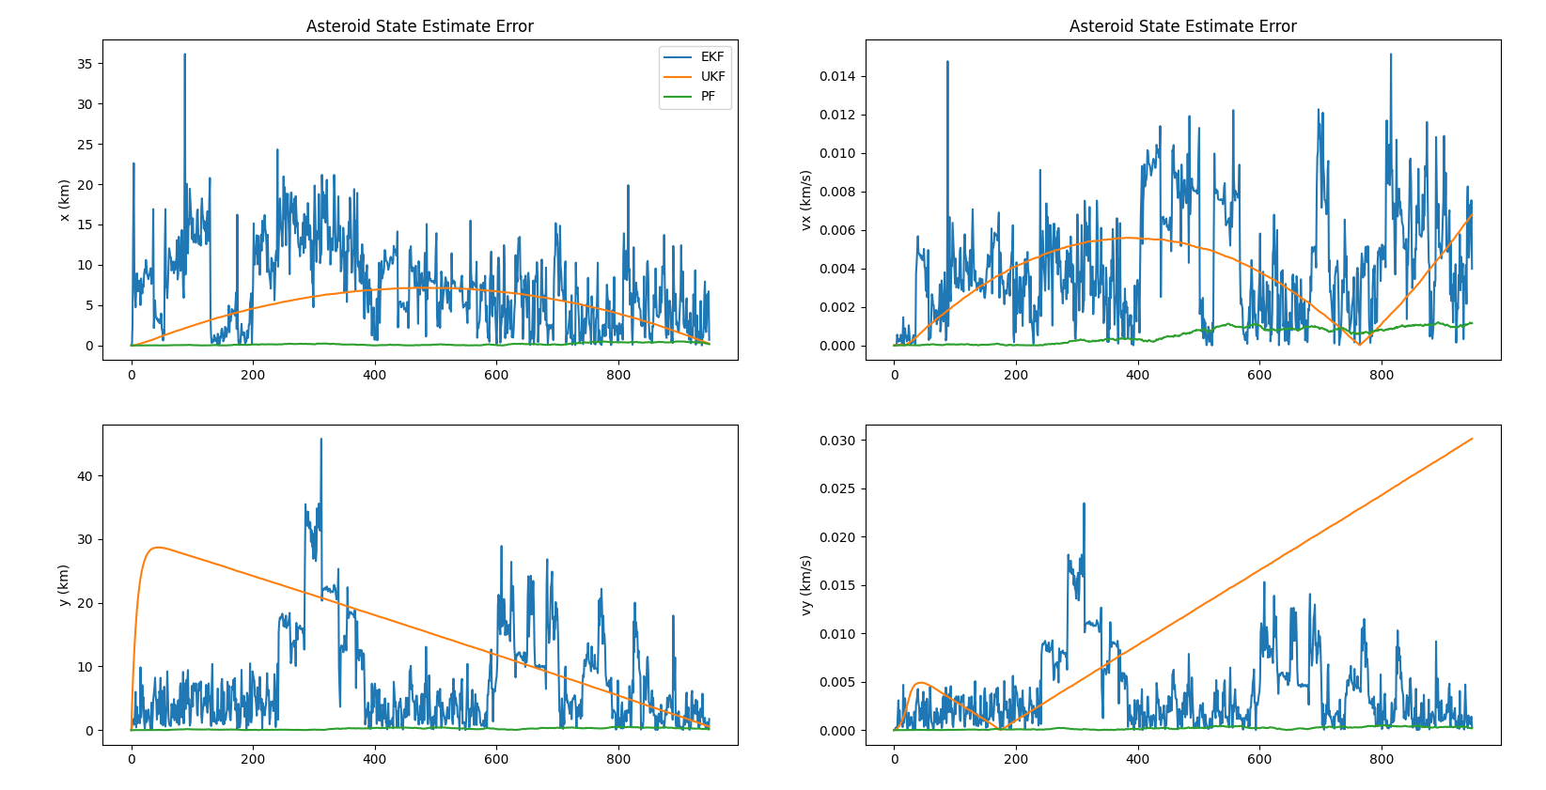
Results: EKF, UKF, PF Error Comparison
Notes:
Ashok-particle filter doesn’t perform well due to few particles and surprisingly the error in the asteroid state is higher for the UKF, and peculiarly the UKF’s belief of the asteroid seems to be a straight line.

Slide 14
Moving Forward
Replan Trajectory based on current estimates
Give spacecraft a gravitational pull from the earth
Use an accurate (not constant) spacecraft mass
Notes:
Ashok

Slide 15
Questions?

